Slide 1
Lecture 6 – ML : Classification
AY 2025-26

Slide 2
Lesson Outline
L6 – ML: Classification
Introduction to Machine Learning
Classification Algorithms
Evaluation of Classification Model

Slide 3
1. Introduction to Machine Learning
Intro. to Machine Learning
Classification vs Regression
Types of Machine Learning

Slide 4
Intro. to Machine Learning
Computer algorithms can learn!
Machine Learning: Computer systems can learn from data, identify patterns and make decisions with minimal human intervention

Slide 5



AlphaGo
https://www.deepmind.com/research/highlighted-research/alphago

Slide 6
Types of Machine Learning
Supervised learning – trained with input and output data (labelled data). Regression and classification are supervised learning algorithms.
Unsupervised learning – trained with input data only (un-labelled data). Clustering are unsupervised algorithms.
Semi-supervised learning – trained with large amount of un-labelled data + small amount of labelled data.
Reinforcement learning – training reinforced by positive and negative rewards in the form of weights or scores. Reinforcement learning is widely used in games.

Slide 7
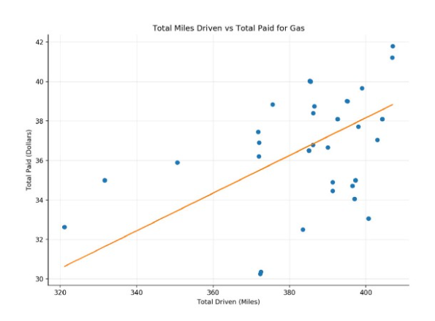
Regression vs Classification
Regression
Predicted output is a continuous value
Examples of output values:
Income
Temperature
Height
volume
Source:
https://towardsdatascience.com/linear-regression-in-real-life-4a78d7159f16

Slide 8
Regression vs Classification
Classification
Predicted output is a categorical variable in the form of class labels. It can be binary (2 classes) or multiclass (> 2 classes)
Examples of output class labels:
Yes/ No (binary)
grade A/B/C/D/E (multiclass)
dayOfWeek Mon/Tue/Wed/Thu/Fri/Sat/Sun (multiclass)
Gender M/F (binary)

Slide 9
Classification Algorithms
Logistic regression
K-Nearest Neighbours (KNN)
Naïve Bayes
Decision Tree
Support Vector Machine (SVM)
Neural Networks (NN)

Slide 10
Common Classification Algorithms
There are many important classification algorithms.
No single method will do well in all classification problems!
Methods based on several classification algorithms:
Voting classification
Ensemble methods

Slide 11
Classification Algorithms
Logistic regression
K-Nearest Neighbours (KNN)
Naïve Bayes
Decision Tree
Support Vector Machine (SVM)
Neural Networks (NN)

Slide 12
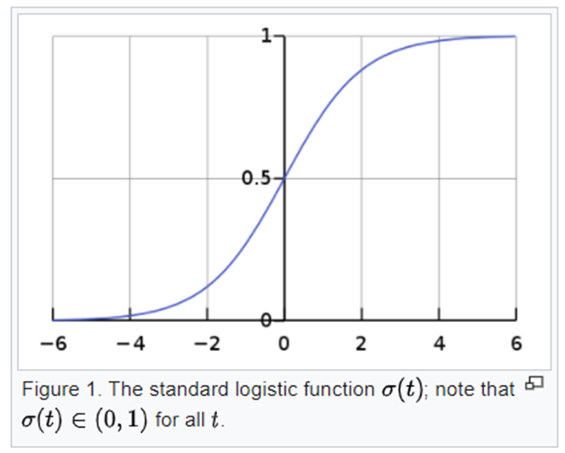
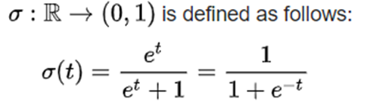
Logistic Regression
Logistic regression (or logit regression) uses a logistic function to model a binary dependent variable
Standard logistic function:
Sigmoid Fcn for output layer of binary NN
Class (0, 1) to model output into probability

Slide 13
Logistic Regression (2)
Logistic regression is a classification algorithm used to find the probability of event success and event failure. It is used when the dependent variable is binary in nature (e.g. 0/1, True/False, Yes/No, Pass/Fail)

Slide 14
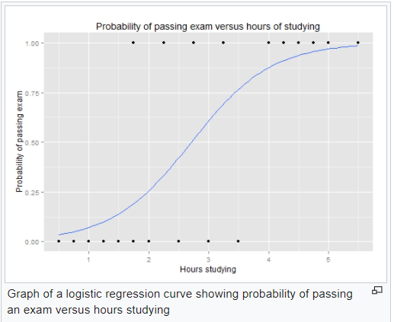
Logistic Regression Curve
Source:
https://en.wikipedia.org/wiki/Logistic_regression

Slide 15
Logistic regression Applications
Applications examples:
Predict disease outcome based on observed symptoms of patients
Predict whether there will be system failure based on machine running statistics
Predict whether a mortgage will become default (cannot be repaid) based on economic and borrower’s data

Slide 16


Example: Logistic Regression
Import dependences
lab6.ipynb (Q.5)
Simulate data for classifcation
Fit the data with a logistic regression model from sklearn

Slide 17

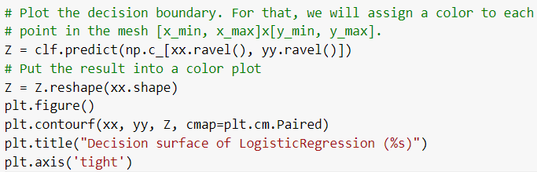
Example: Logistic Regression (2)
Create color map to show the results
lab6.ipynb (Q.5)
Plot the boundaries and grids

Slide 18
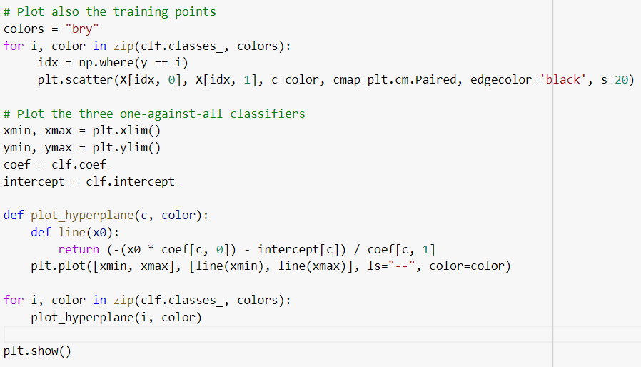
Example: Logistic Regression (3)
Plot and output the results
lab6.ipynb (Q.5)

Slide 19
Applications:
Medical Diagnosis: Predicting the presence of a disease.
Spam Detection: Classifying emails as spam or not spam.
Customer Conversion Prediction: Predicting customer response to marketing campaigns.
Credit Scoring: Assessing loan approval risk based on customer information.
Image Recognition: Classifying images like handwritten digits.
Sentiment Analysis: Determining positive, negative, or neutral sentiment in text.
Student Performance Prediction: Predicting whether a student will pass or fail based on various features.

Slide 20
Advantages and Disadvantages of Logistic Regression
Advantages
Simple to implement
Fast training
Disadvantages
Overfitting (if number of observations is less than the number of input features)

Slide 21
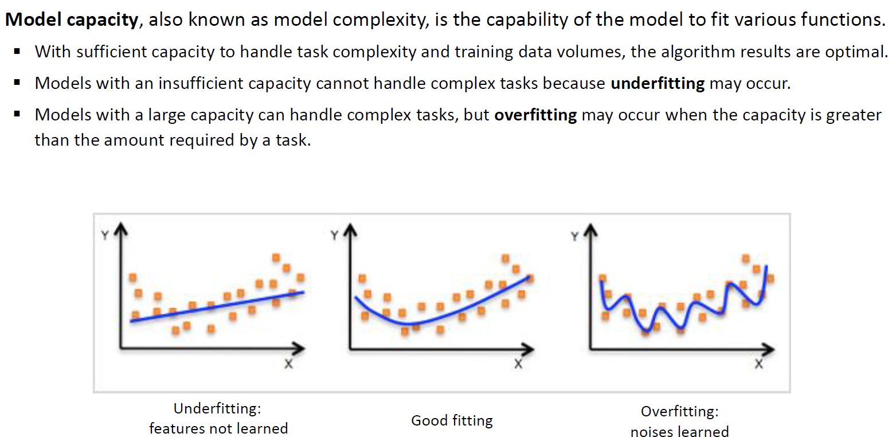

Slide 22
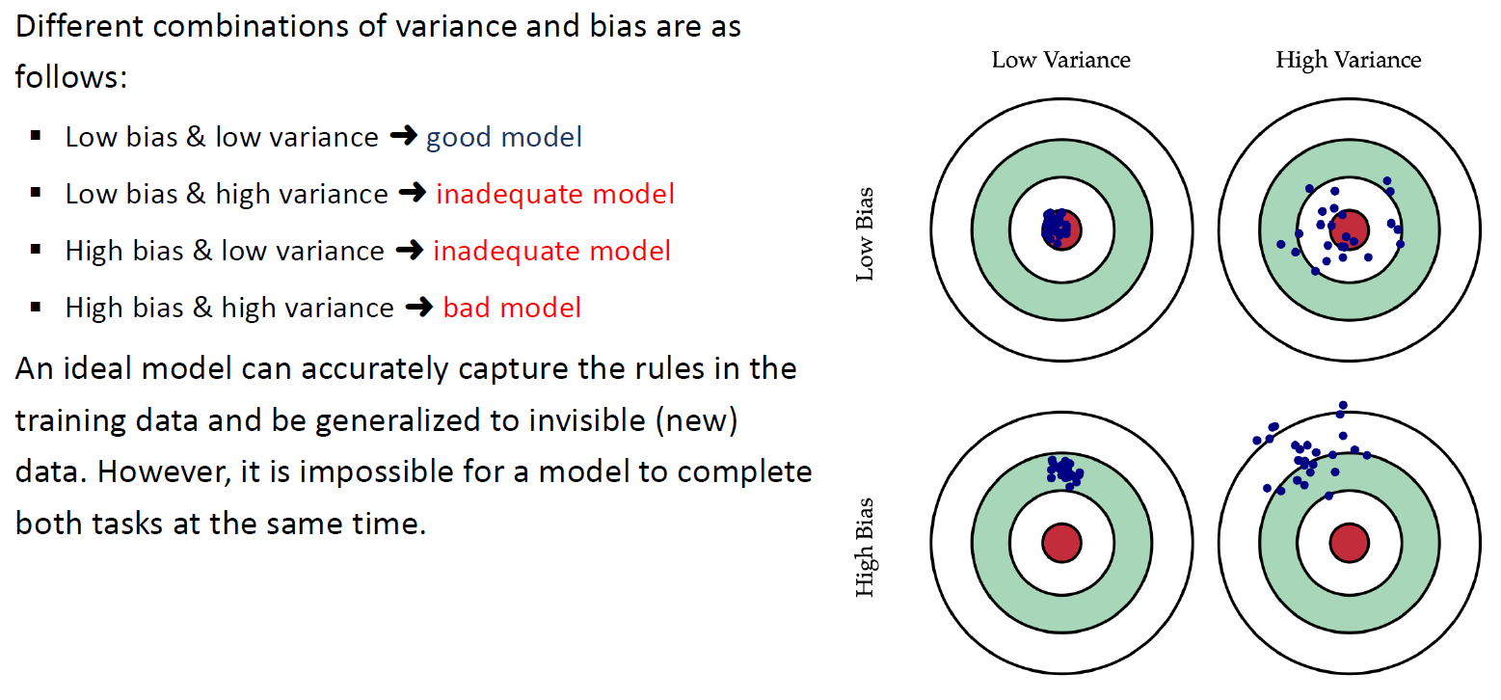
Variance & Bias

Slide 23
Classification Algorithms
Logistic regression
K-Nearest Neighbours (KNN)
Naïve Bayes
Decision Tree
Support Vector Machine (SVM)
Neural Networks (NN)

Slide 24
K-Nearest Neighbours (KNN)
The k-nearest neighbors (k-NN) algorithm is a classification algorithm that predicts the class of an instance based on the classes of its k nearest neighbors in the feature space.

Slide 25
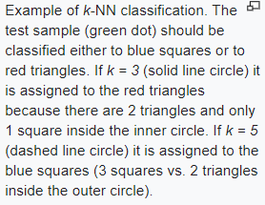
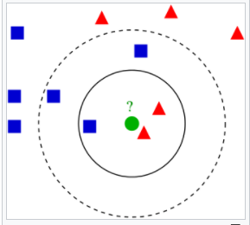
Source:
https://en.wikipedia.org/wiki/K-nearest_neighbors_algorithm

Slide 26
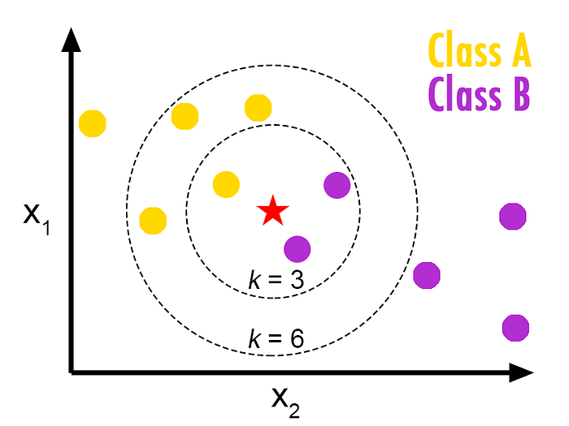
Examples
In a 2-D plane, suppose the yellow points are labelled as “Cat”
The purple points are labelled as “Dog”
To classify the new data point (the red star) belongs to class “Cat” or “Dog”, we need to specify the number of “neighbors” (K).
If k = 3, the red star would be classified as “Dog”
If k = 6, it would be classified as “Cat”

Slide 27
K-Nearest Neighbours (KNN)
Assign the data to one of the classes (categories) based on the average values of its K nearest neighbours.
Weights can be assigned to the contribution of the neighbours
KNN is sensitive to the local structure of the data

Slide 28
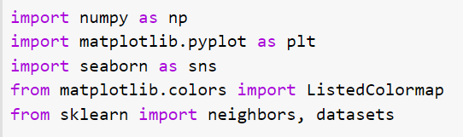
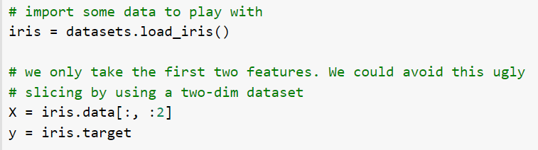
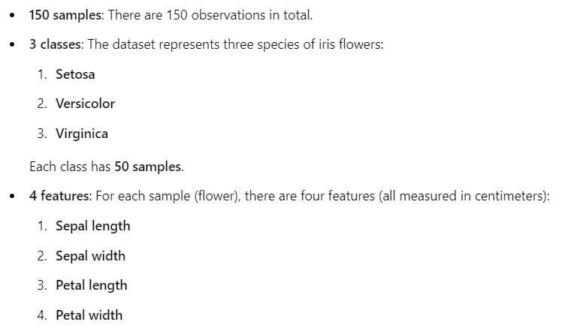
Example: KNN
Import dependences
lab6.ipynb (Q.3)
Load data

Slide 29

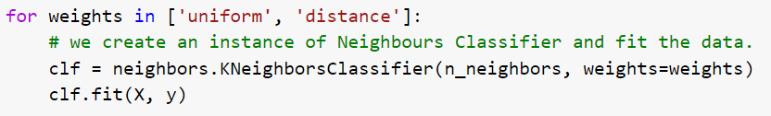
Example: KNN (2)
Define the number of neighbours N
lab6.ipynb (Q.3)
Fit the data using kNeighborsClassifier model from sklearn

Slide 30
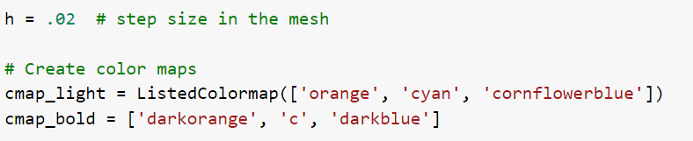
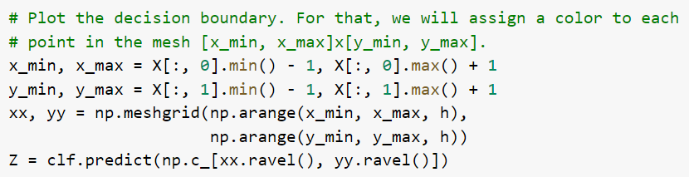
Example: KNN (3)
Create color map to show the results
lab6.ipynb (Q.3)
Plot the boundaries and grids

Slide 31
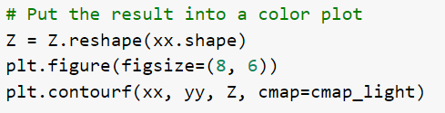
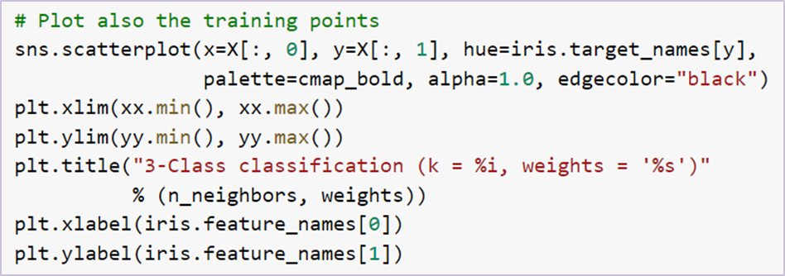

Example: KNN (4)
Plot and output the results
lab6.ipynb (Q.3)

Slide 32
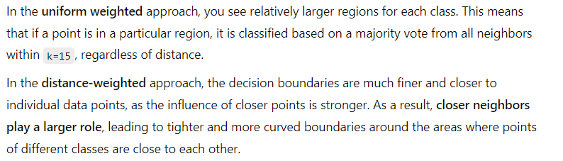
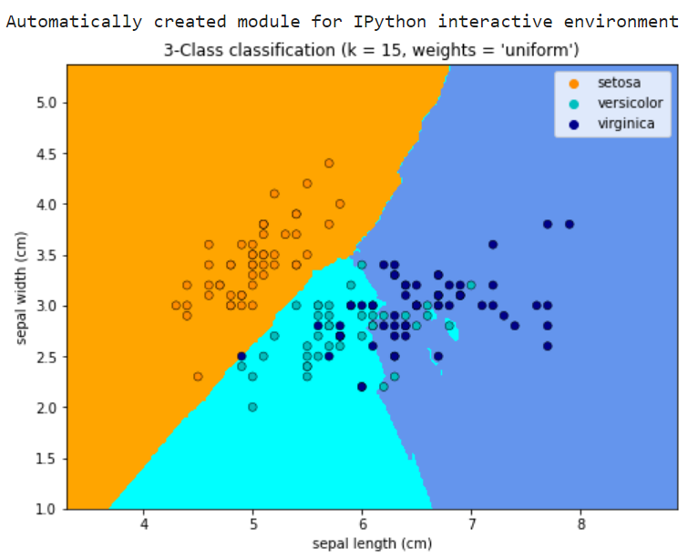
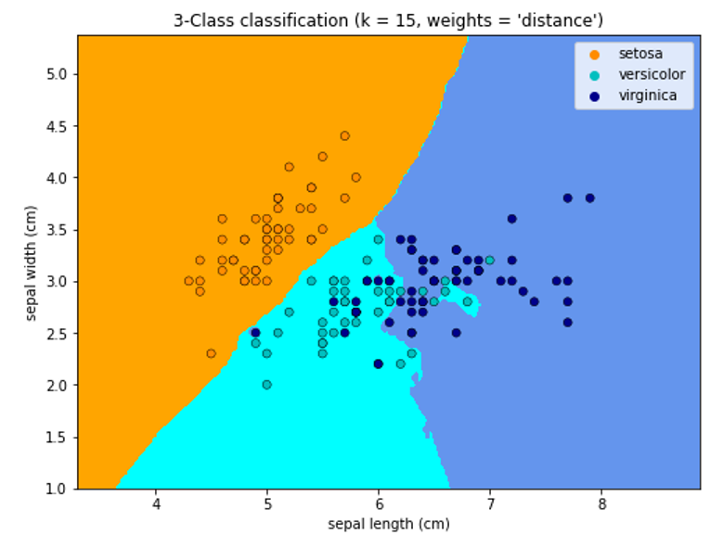
Example: KNN (5)
Output
lab6.ipynb (Q.3)
generalized decision boundary
detailed decision boundary

Slide 33
weights='uniform': Each of the k-nearest neighbors contributes equally to classification, regardless of distance. This results in smoother boundaries with less contour and is ideal for cases where all neighbors have the same influence.
weights='distance': Closer neighbors contribute more to classification. This creates more detailed boundaries, emphasizing proximity and providing more accuracy in areas where classes overlap.

Slide 34
Advantages and Disadvantages of KNN
Advantages
Does not requires training period, therefore runs much faster
New data can be added without affecting the accuracy of the algorithm
Easy to implement
Disadvantages
Does not work well with large datasets
Does not work well with high dimensions
Sensitive to noisy data, missing values and outliers

Slide 35
Classification Algorithms
Logistic regression
K-Nearest Neighbours (KNN)
Naïve Bayes
Decision Tree
Support Vector Machine (SVM)
Neural Networks (NN)

Slide 36
Naïve Bayes
Naïve Bayes is a classification algorithm that classifies according to “Maximum likelihood Principle” (i.e. to the class with the highest posterior probability)
It calculates likelihood by the Bayes’ Theorem

Slide 37
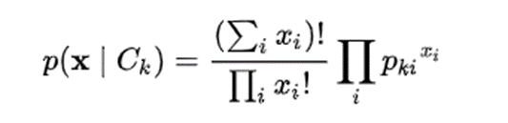
Naïve Bayes
To classify K possible outcomes (i.e. classes) C_{k} based on some n independent variables X = (x₁, …, x_{n}) ,
the probability can be written as p(C_{k} | x₁,…,x_{n}).
For example, if X ~ multinomial distribution, the posterior probability can be given by :

Slide 38
Assumptions
Naïve Bayes assumes that all predictors are independent.
That is, the presence of one particular feature in a class does not affect the presence of another.

Slide 39
Examples (1)
Suppose we want to predict whether James would go out play or not, based on the weather condition.
Target Variable: Play or not play
Input Variable: Weather

Slide 40
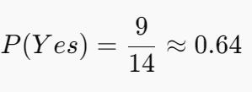
Examples (2)
Weather | Play?
Sunny | No
Sunny | No
Cloudy | Yes
Rainy | Yes
Rainy | Yes
Rainy | No
Cloudy | Yes
Sunny | No
Sunny | Yes
Rainy | Yes
Sunny | Yes
Cloudy | Yes
Cloudy | Yes
Rainy | No
Find the Probability of Playing Overall:
We calculate how often James played in all types of weather. This is called P(Yes).
Source:
https://www.datacamp.com/community/tutorials/naive-bayes-scikit-learn

Slide 41
Examples (3)
Find the Probability of Cloudy Weather: We calculate how often the weather was cloudy compared to all other weather conditions. This is called P(Cloudy).
Weather | No | Yes
Cloudy | 0 | 4
Sunny | 2 | 3
Rainy | 3 | 2
Total | 5 | 9
P(Cloudy) = 4/14 ≈ 0.29

Slide 42
Examples (4)
Find the Probability of Playing Overall: We calculate how often James played in all types of weather. This is called P(Yes).
Weather | No | Yes
Cloudy | 0 | 4 | 4/14 | 0.29
Sunny | 2 | 3 | 5/14 | 0.36
Rainy | 3 | 2 | 5/14 | 0.36
Total | 5 | 9
 | 5/14 | 9/14
 | 0.36 | 0.54

Slide 43
Examples (5)
Probability of Cloudy Given Playing: We calculate how often the weather was Cloudy when James decided to play.
Weather | No | Yes | Posterior Probability for No | Posterior Probability for Yes
Cloudy | 0 | 4 | 0/5=0 | 4/9=0.44
Sunny | 2 | 3 | 2/5=0.4 | 3/9=0.33
Rainy | 3 | 2 | 3/5=0.6 | 2/9=0.22
Total | 5 | 9

Slide 44
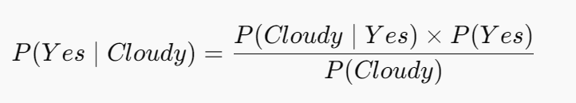
Examples (6)
Now suppose you want to calculate the probability of playing when the weather is Cloudy.
Probability of playing:

Slide 45
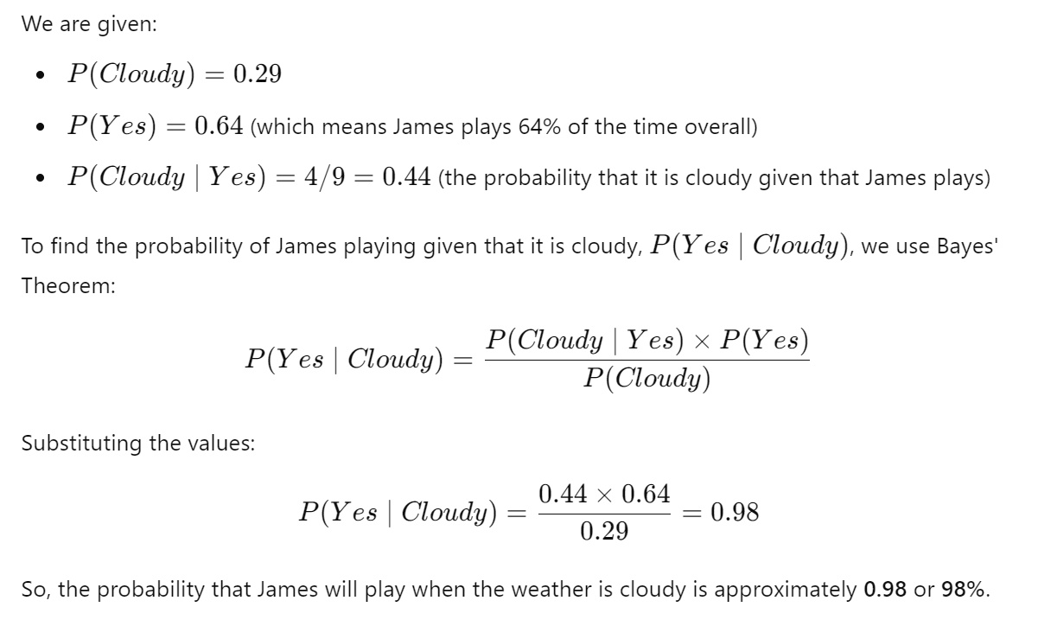
Examples (7)

Slide 46
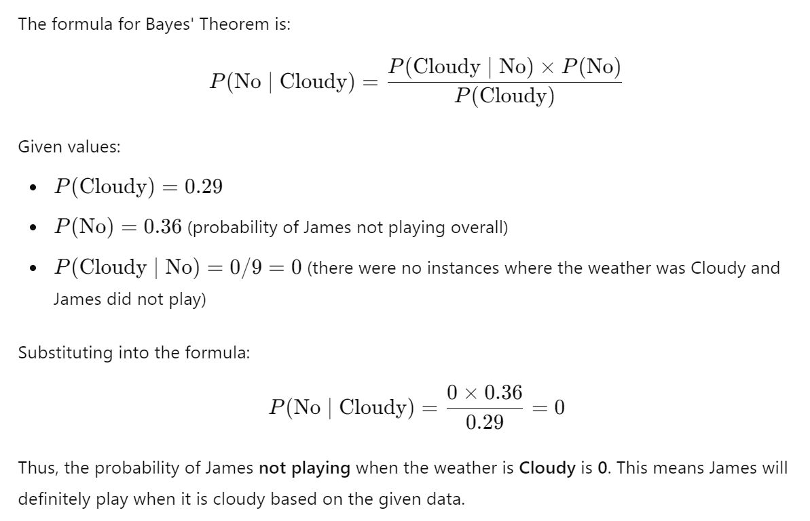
Examples (8)

Slide 47

Example: Naïve Bayes
Import dependences
NB.ipynb
Load and split data
Fit a Gaussian Naïve Bayes model from sklearn
Predict the test set

Slide 48

Example: Naïve Bayes (2)
Display results
NB.ipynb
Output results
Evaluation
Output evaluation result

Slide 49
Advantages and Disadvantages of Naïve Bayes Classifier
Advantages
Simple but powerful algorithms
Suitable for multi-class prediction
Suitable for categorical input variables
Disadvantages
Need to assumes that all predictors are independent
Zero-frequency problem for those categories with low frequencies
Estimators can be wrong in some cases

Slide 50
Classification Algorithms
Logistic regression
K-Nearest Neighbours (KNN)
Naïve Bayes
Decision Tree
Support Vector Machine (SVM)
Neural Networks (NN)

Slide 51
Decision Tree
a supervised machine learning algorithm that is used for classification and regression analysis
recursively partitioning the input data into smaller subsets based on the values of the input features
until a stopping criterion is met

Slide 52
Decision Tree
Each internal node of the decision tree represents a test on an input feature.
Each leaf node represents a class label or a numerical value.

Slide 53
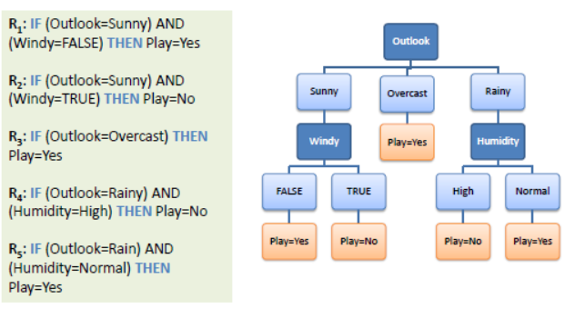
An illustration

Slide 54
“Splitting” the Decision Tree
At each node, the “best” split (i.e. branch) is obtained by calculating how much “accuracy” (for prediction) each split will gain, the split with maximum gain is chosen

Slide 55
“Splitting” the Decision Tree
Decision trees target variables can be categorical or numerical
Examples:
Categorical target variables:
An email spam or not spam?
Numerical target variables:
Budget > 10,000?
Age = 25?

Slide 56
The "best“ split
Common metrics for measuring the "best" split :
ID3 (Entropy and Information Gain)
Gini Index
Chi-Square
Reduction in Variance

Slide 57
ID3 Algorithm
invented by Ross Quinlan, a computer scientist and professor at the University of Sydney, in 1986
employs a top-down, greedy search through the space of possible branches with no backtracking
uses Entropy and Information Gain to construct a decision tree

Slide 58
Entropy
What is entropy?
A decision tree is built top-down from a root node and involves partitioning the data into subsets that contain instances with similar values (homogenous).
ID3 algorithm uses entropy to calculate the homogeneity of a sample.

Slide 59
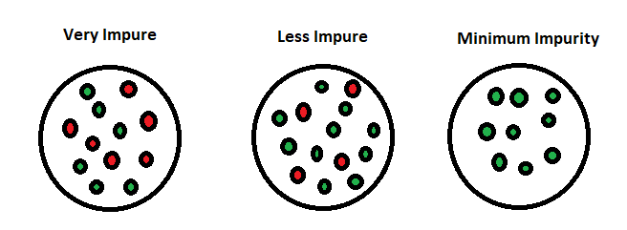
Entropy

Slide 60
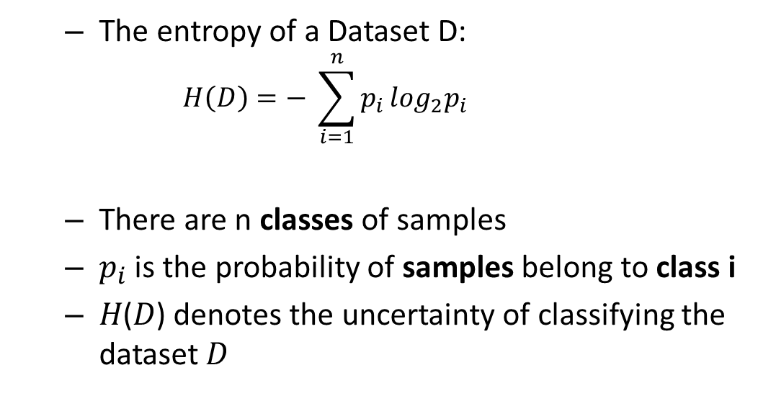
Entropy
The entropy of a Dataset D:
$$H\left(D\right)=− \sum_{i=1}^{n}{p_{i}}\log_{2}p_{i}$$
There are n classes of samples
$p_{i}$ is the probability of samples belong to class i
𝐻(𝐷) denotes the uncertainty of classifying the dataset 𝐷

Slide 61
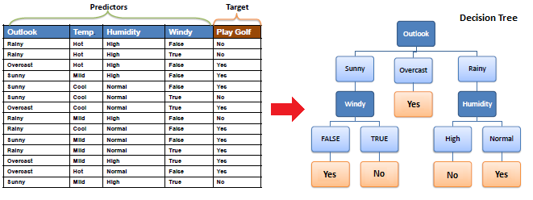
Entropy of a Dataset: Example

Slide 62
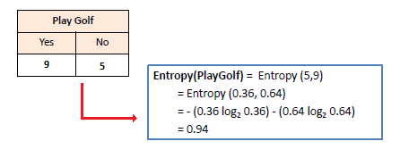
Entropy of a Dataset: Example (1)
Identify the number of classes in target variable:

Slide 63
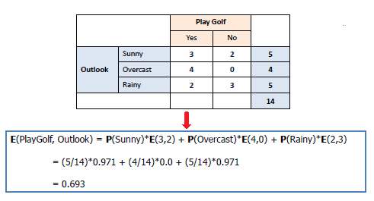
Entropy of a Dataset: Example (2)
Identify the outlook once the “Play Golf” = Yes and No

Slide 64
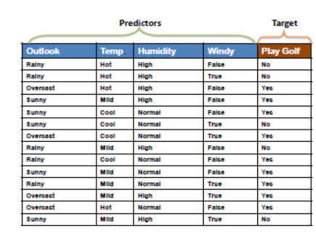

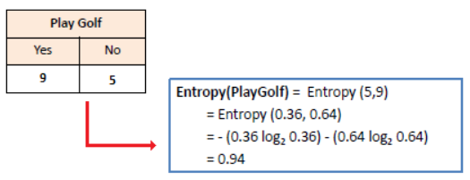
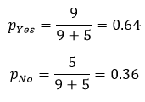
Entropy and Information Gain
Entropy E(S)
e.g. Predict Play Golf / Not Play
Source:
https://www.saedsayad.com/decision_tree.htm
Information Gain (Decrease in entropy/ uncertainty) for a split
= E(not split) – E (split)
At each node:
calculate the information gain for every possible split
Choose the split with the maximum information gain

Slide 65
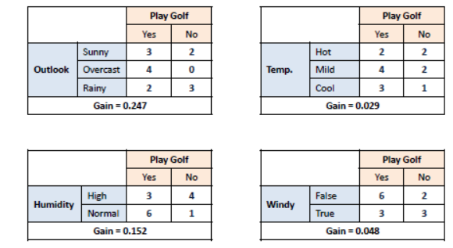
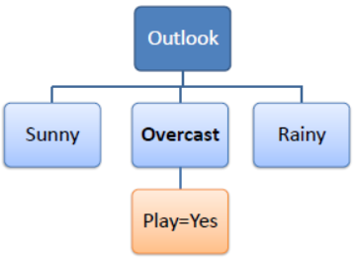
Entropy and Information Gain (2)
Gain = 0.247 is maximum among all splits -> choose to split at “Outlook”:

Slide 66
Entropy and Information Gain (3)
Repeat the steps until the complete decision tree is generated

Slide 67

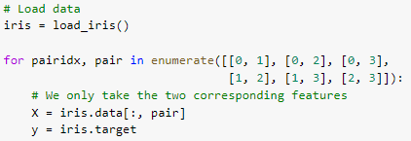
Example: Decision Tree
Import dependences
DTree.ipynb
Load data

Slide 68

Example: Decision Tree (2)
DTree.ipynb
Fit the data using DecisionTreeClassifier model from sklearn
Plot the tree

Slide 69
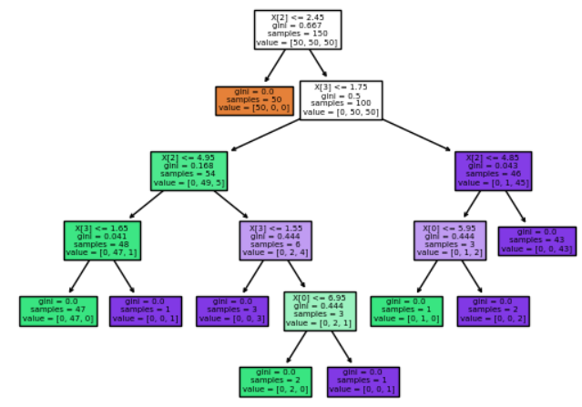
Example: Decision Tree (3)
Output
DTree.ipynb

Slide 70
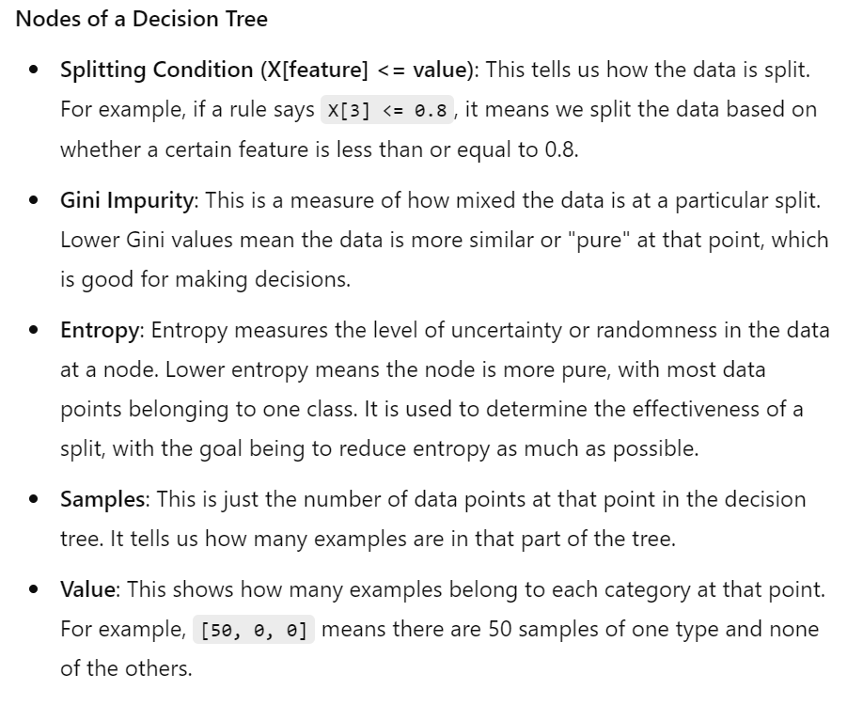

Slide 71
Advantages and Disadvantages of Decision Tree
Advantages
Easy to understand
Easy to generate rules
Used for both classification and regression
Non-parametric (i.e. there is no assumption on the distribution)
Disadvantages
Overfitting
Classifies by rectangular partitioning (for which no efficient solution algorithm has been found)
Pruning (i.e. selective removal of certain parts) is necessary for large trees

Slide 72
Classification Algorithms
Logistic regression
K-Nearest Neighbours (KNN)
Naïve Bayes
Decision Tree
Support Vector Machine (SVM)
Neural Networks (NN)

Slide 73

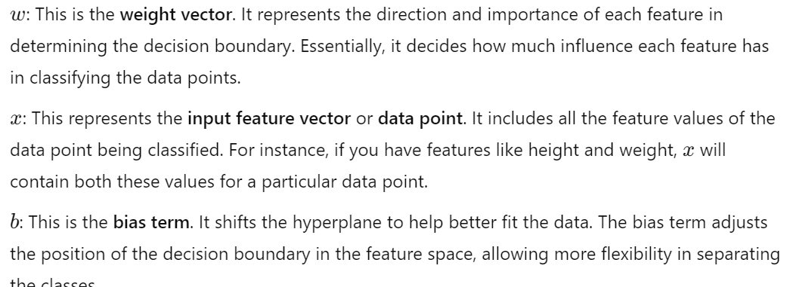
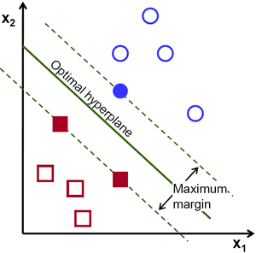
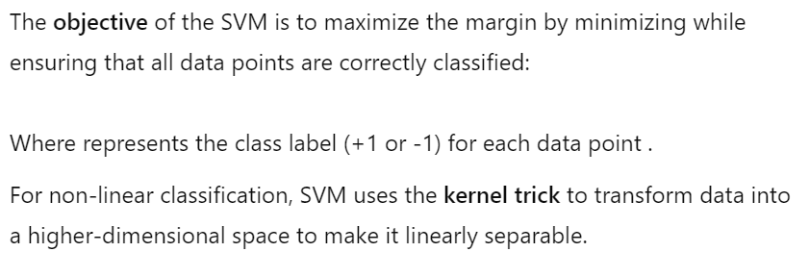
Support Vector Machine (SVM)

Slide 74
Support Vector Machine (SVM)
In classification, the objective of SVM is to find a hyperplane that maximally separates the classes in the feature space
SVMs work by finding the best decision boundary that separates the instances belonging to different classes with the maximum margin.

Slide 75
Advantages and Disadvantages of SVM
Advantages
Can handle data points not linearly separable
Effective in high dimension
Robust (i.e. less affected by noisy data)
Disadvantages
Not suitable when number of input features
> numbers of training samples
Overfitting (Not robust to outliers)

Slide 76
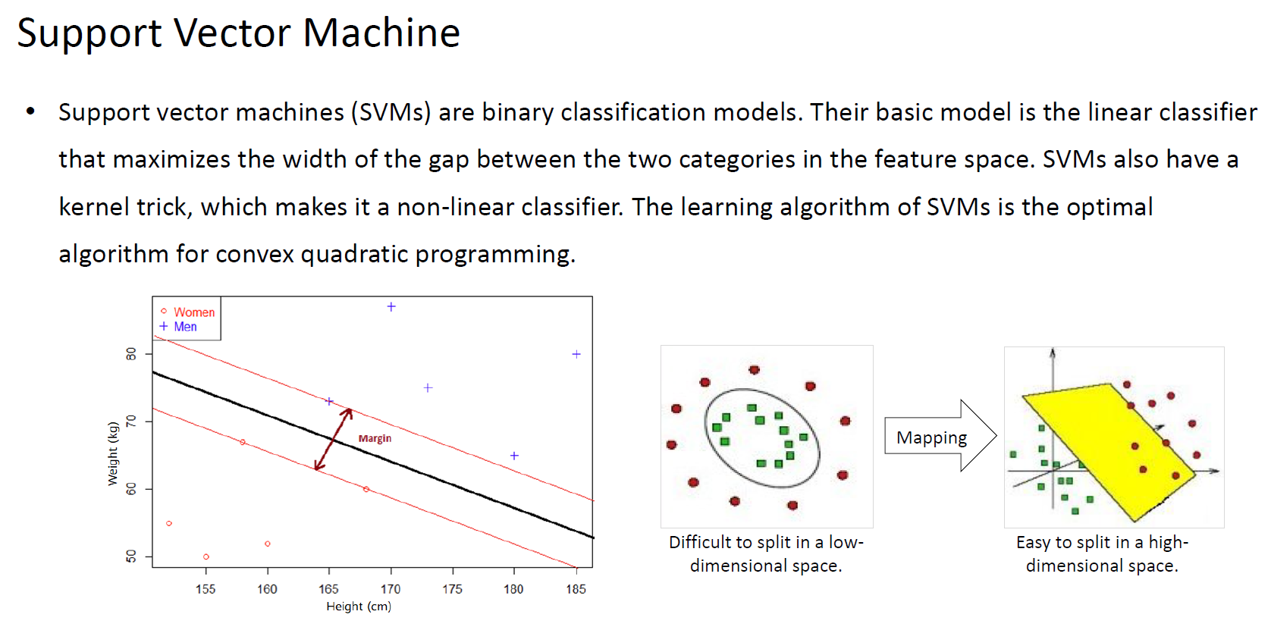

Slide 77
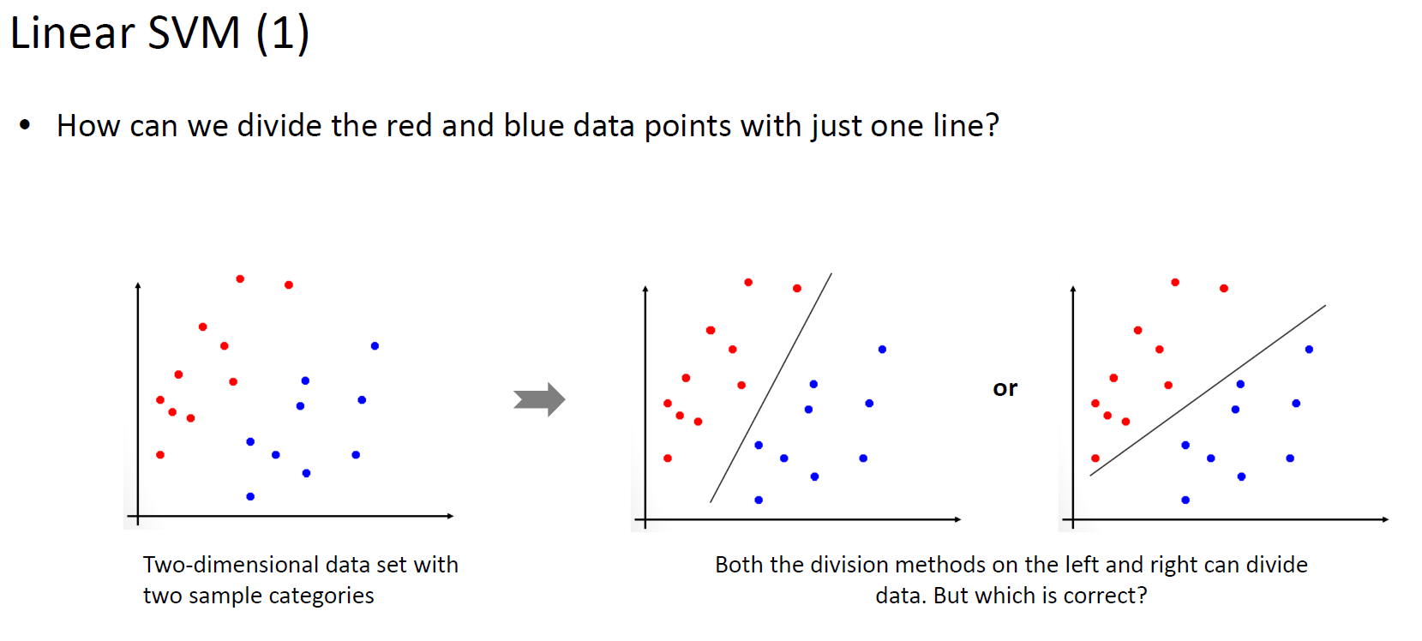

Slide 78
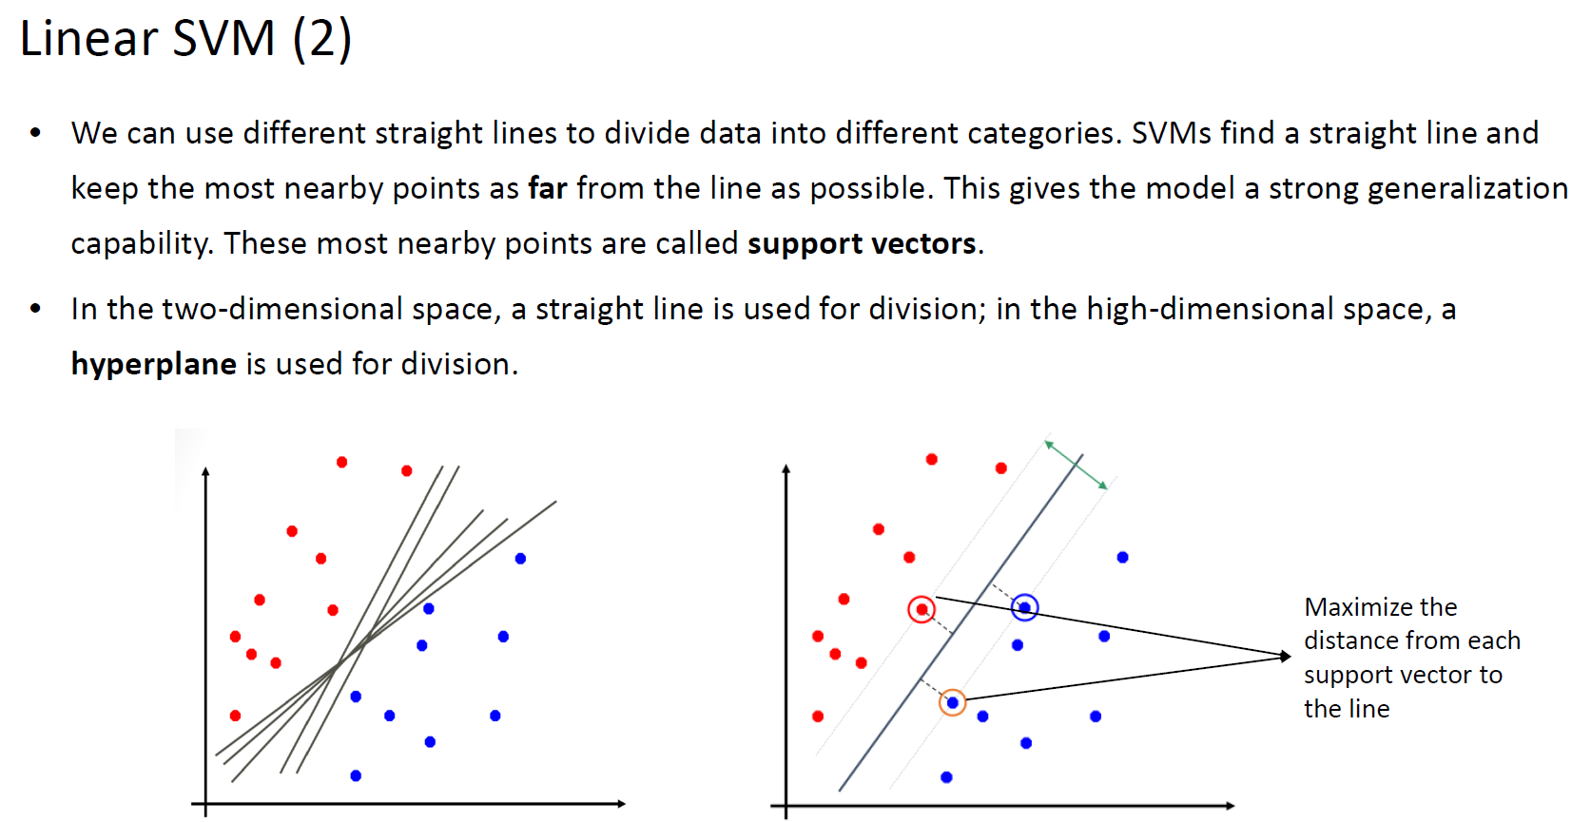

Slide 79
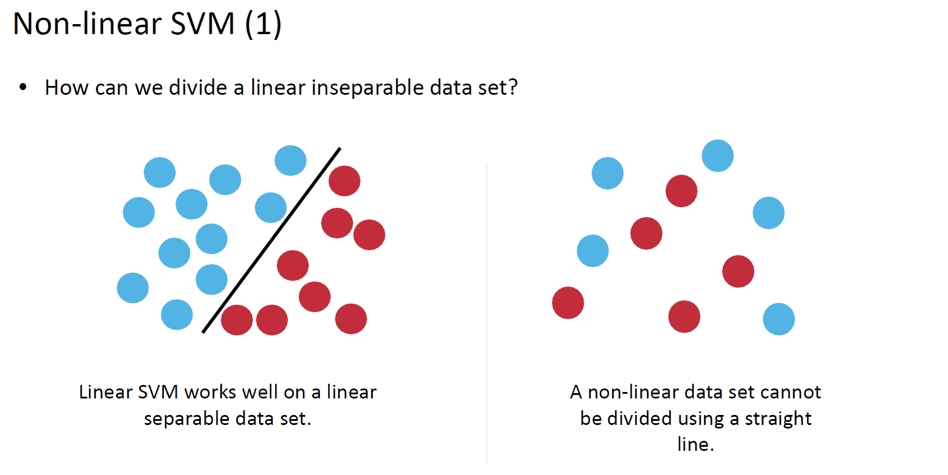

Slide 80
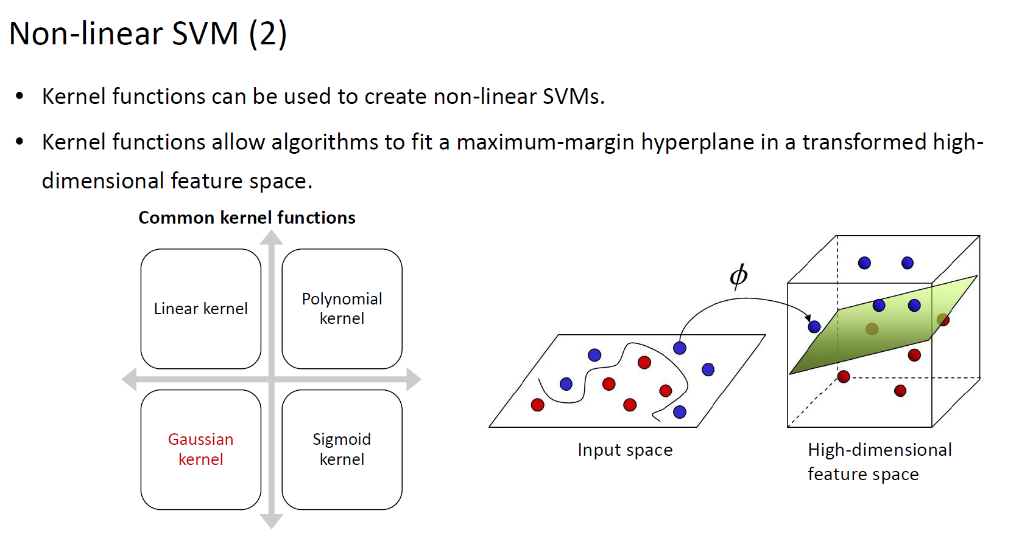

Slide 81
8. Evaluation of Classification Model
Confusion matrix
Other methods

Slide 82
Confusion Matrix
a table that is used to evaluate the performance of a classification model
by comparing the predicted labels to the actual labels
Can be used to count the number of cases predicted correctly or wrongly

Slide 83
Some terminologies
True positive (TP): correct positive prediction
Actual value is “Spam”, and predicted value is also “Spam”
False positive (FP): incorrect positive prediction
Actual value is “Spam”, but predicted value is “Not Spam”
True negative (TN): correct negative prediction
Actual value is “Not Spam”, and predicted value is also “Not Spam”
False negative (FN): incorrect negative prediction
Actual value is “Not Spam”, but predicted value is “Spam”

Slide 84
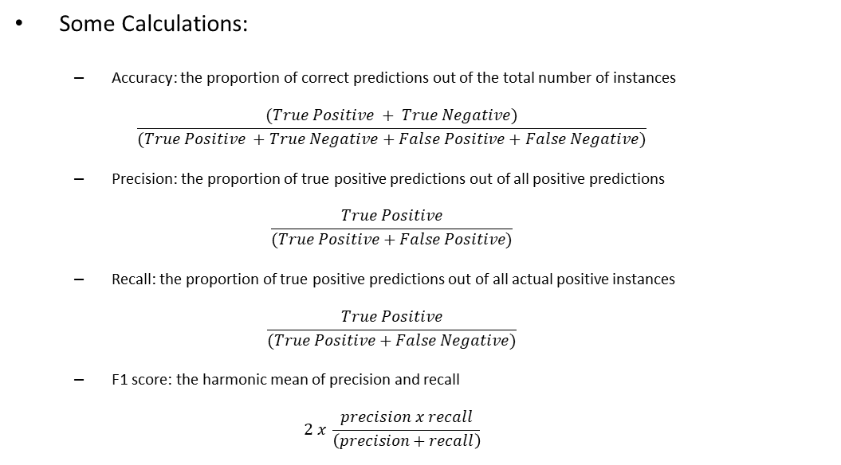
Some terminologies
Some Calculations:
Accuracy: the proportion of correct predictions out of the total number of instances
$$\frac{(True Positive + True Negative)}{(True Positive +True Negative+False Positive+False Negative)}$$
Precision: the proportion of true positive predictions out of all positive predictions
$$\frac{True Positive}{(True Positive+False Positive)}$$
Recall: the proportion of true positive predictions out of all actual positive instances
$$\frac{True Positive}{(True Positive+False Negative)}$$
F1 score: the harmonic mean of precision and recall
$$2 x \frac{precision x recall}{\left(precision+recall\right)}$$

Slide 85

Some terminologies
True Positive Rate:
$\frac{True Positive}{(True Positive+False Negative)}$
False Positive Rate:
$\frac{False Positive}{(True Negative+False Positive)}$

Slide 86

Confusion Matrix (Binary)
Counting the number of cases predicted correctly or wrongly
True positive (TP):
correct positive prediction
False positive (FP):
incorrect positive prediction
True negative (TN):
correct negative prediction
False negative (FN):
incorrect negative prediction

Slide 87
Confusion Matrix: An example
Suppose we have a model that predicts whether an email is spam (positive) or not spam (negative), and we have a test set of 500 emails with known labels.

Slide 88
Confusion Matrix: An example
The model makes the following predictions:
TP: 140 emails are correctly classified as spam.
FP: 180 emails are incorrectly classified as spam.
TN: 80 emails are correctly classified as not spam.
FN: 100 emails are incorrectly classified as not spam.

Slide 89

Confusion Matrix: An example
Accuracy : (140 + 80)/ (140 + 180 + 80 + 100) = $\frac{220}{500}=0.44$
Precision : 140 / (140 + 180) = $\frac{140}{320}=0.4375 ≈0.44$
Recall : 140 / (140 + 100) = $\frac{140}{240}=0.58333… ≈0.58$
F1 score : 2 * ((0.44 * 0.58) / (0.44 + 0.58)) = 0.5104 $≈$ 0.51
True Positive Rate = 140 / (140 + 100) = $\frac{140}{240}=0.58333… ≈0.58$
False Positive Rate = 180 / (180 + 80) = $\frac{180}{260}=0.69230… ≈0.69$

Slide 90

Multiclass confusion matrix
A 2x2 Confusion Matrix is suitable for 2-class classification task.
What if we have number of classes > 2?
Example includes the Iris Dataset, where the target variables (outputs) are Versicolor, Virginia, and Setosa.

Slide 91

Multiclass confusion matrix
Source: https://www.analyticsvidhya.com/blog/2021/06/confusion-matrix-for-multi-class-classification/

Slide 92

Self Study Guide

Slide 93
Self Study Guide
References
Müller, A.C. & Guido, S. (2016). Introduction to Machine Learning with Python: A Guide for Data Scientists (1st ed.). Sebastopol, CA: O’Reilly.
Géron, A. (2017). Hands-On Machine Learning with Scikit-Learn and TensorFlow: Concepts, Tools, and Techniques to Build Intelligent Systems (1st ed.). Sebastopol, CA: O’Reilly.

Slide 94
Self Study Guide
Useful Sites
https://scikit-learn.org/stable/auto_examples/linear_model/plot_logistic_multinomial.html#sphx-glr-auto-examples-linear-model-plot-logistic-multinomial-py
https://scikit-learn.org/stable/auto_examples/neighbors/plot_classification.html#sphx-glr-auto-examples-neighbors-plot-classification-py
https://scikit-learn.org/stable/auto_examples/classification/plot_digits_classification.html#sphx-glr-auto-examples-classification-plot-digits-classification-py
Python Examples of sklearn.naive_bayes.GaussianNB (programcreek.com)
https://scikit-learn.org/stable/auto_examples/tree/plot_iris_dtc.html#sphx-glr-auto-examples-tree-plot-iris-dtc-py

